Slide 1




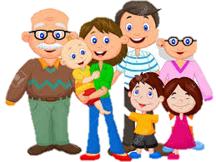
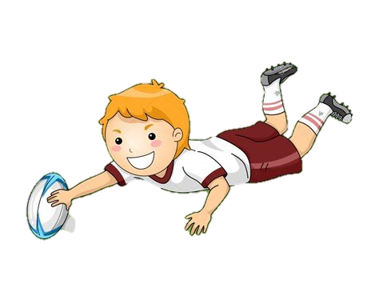


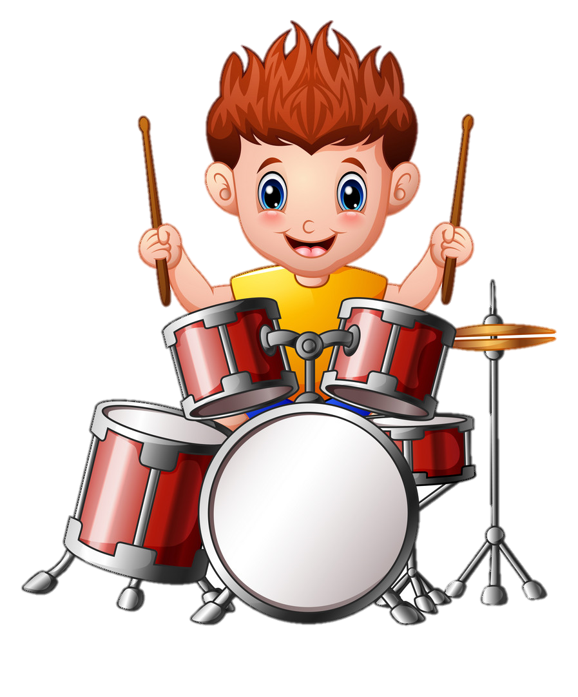

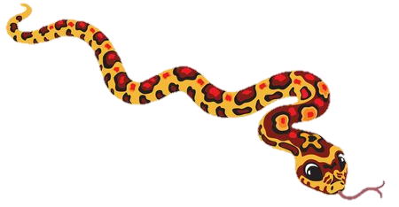
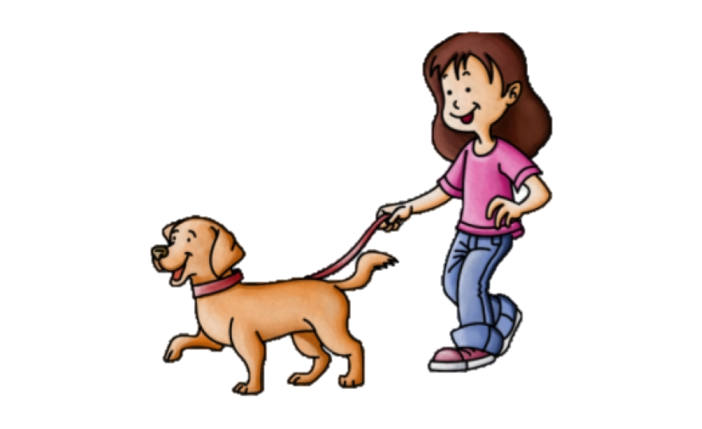
JIGSAW CURRICULUM MAP
Each Puzzle has six Pieces (lessons) which work towards an ‘end product’, for example, The School Learning Charter or The Garden of Dreams and Goals.
The whole school works on the same Puzzle at the same time, meaning that each Puzzle is linked to our assembly theme and learning can be celebrated by the whole school in a meaningful way.
.
Changing Me/SRE
Piece 6
This puzzle includes sex and relationships education in the context of coping positively with change. (includes age-appropriate sex education
Summer
Term
2
Piece 5
Includes understanding friendship, family and other relationships, conflict resolution and communication skills
Relationships
Summer
Term
1
’.
Spring
Term
2
Healthy Me
Piece 4
Includes drugs and alcohol education, self-esteem and confidence as well as healthy lifestyle choices.
Dreams and Goals
Spring
Term
1
Piece 3
.
Includes goal-setting, aspirations for yourself and the world and working together.
Autumn
Term
2
Celebrating Differences
Piece 2
Includes anti-bullying (cyber and homophobic bullying included) and diversity work.
Being me in my world
Autumn
Term
1
Piece 1
Includes understanding my place in the class, school and global community as well as devising Learning Charters.

