Slide 1
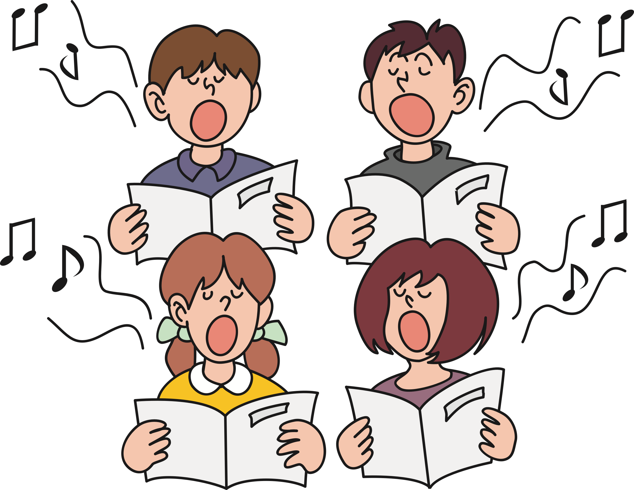


Connaught Junior School Choir
Summer 2020

Slide 2



Warm-Up!
Stretch up high!
Flop down low!
Roll shoulders forwards and now backwards!
Take a deep, full breath. Breathe in for 4 beats and release the air, hissing like a snake.
Breathe in for 4 beats – hold for 4 beats – pulse on ‘shhh’ for 8 beats!
Imagine you have a sticky toffee in your mouth and chew and chew!

Slide 3
Warm Up Shapes
1.
2.
3.
5.
Now see if you can follow these shapes with your voice.
4.

Slide 4
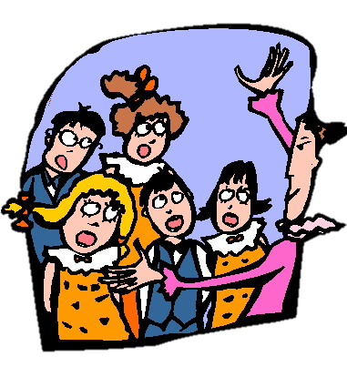

Boom Chicka Boom!
Boom chicka boom (performance track)
Leader: Say "Boom Chicka Boom"
Echo: Say "Boom Chicka Boom"
Leader: Say "Boom Chicka Boom"
Echo: Say "Boom Chicka Boom"
Leader: Say "Boom Chicka Rocka Chicka Rocka Chicka Boom"
Echo: Say "Boom Chicka Rocka Chicka Rocka Chicka Boom"
Leader: "Ah ha!"
Echo: "Ah ha!"
Leader: "Ee hee!"
Echo: "Eh hee!"
Leader: "One more time"
Echo: "One more time"
Leader: *** "Faster"
Echo: "Faster" ***
At this point, there is a new instruction to change the pitch, speed or quality for the next verse eg. "Faster" (speak quickly) or "Slower" (speak slowly), "Higher" (high, squeaky voice), "Lower" (deep voice), "Louder", "Whispering"," Holding your noses", "In a posh voice" etc. To end the song the words "One more time" will be followed by "That's all".

Slide 5
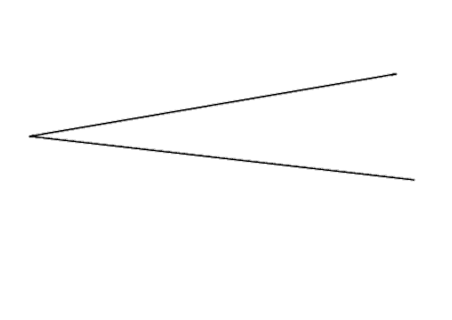

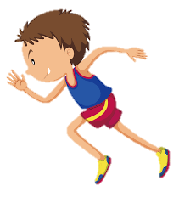

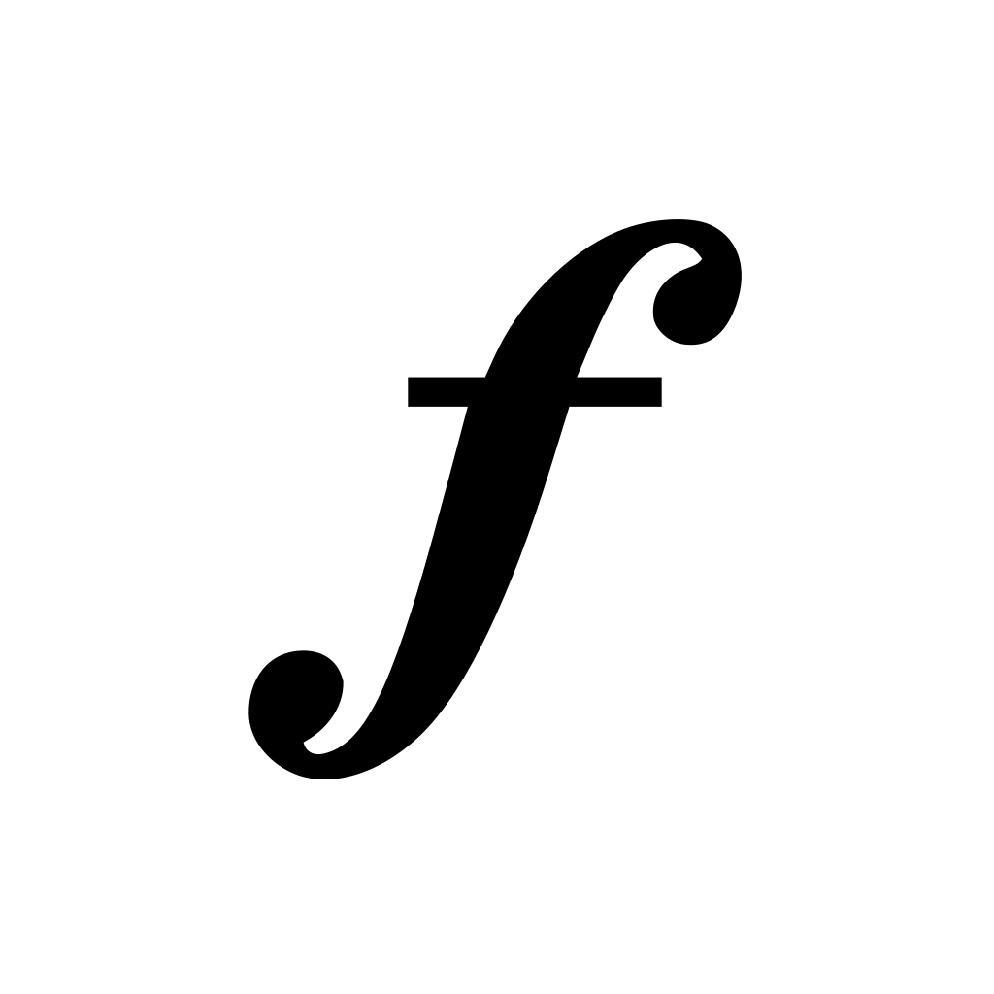
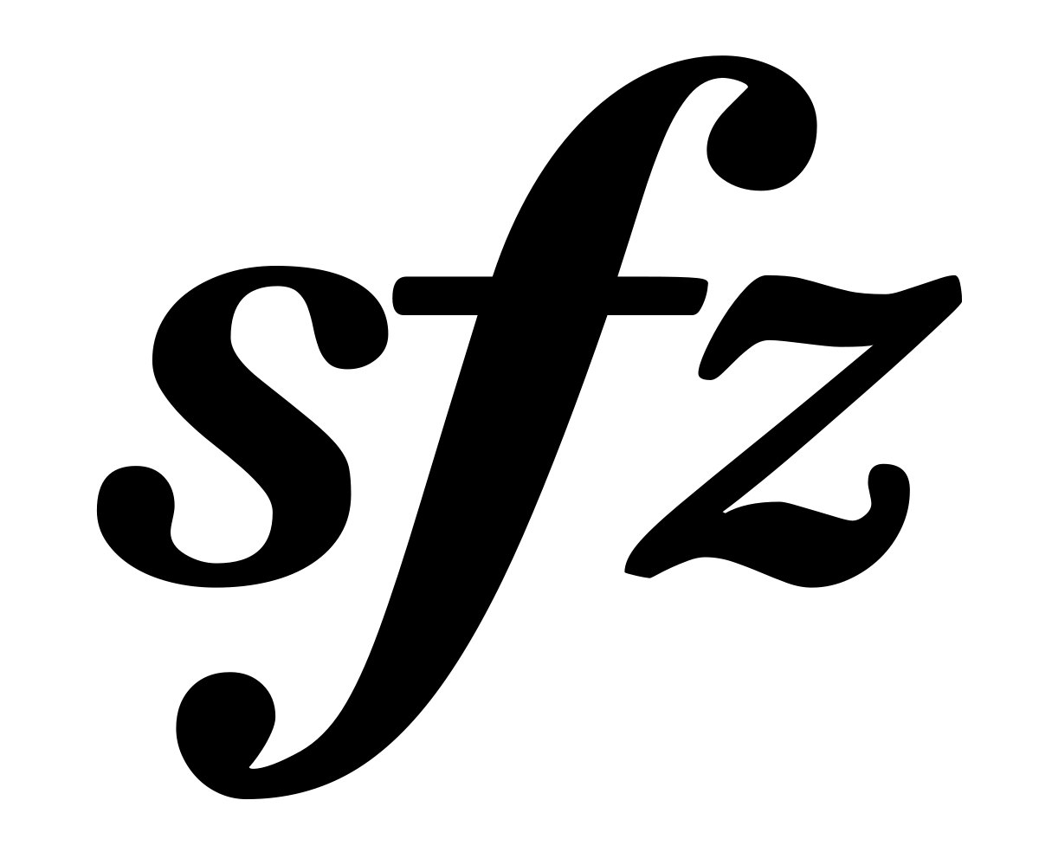

Music Italiano
Music uses lots of Italiano,
Loud is forte, soft is piano,
Gradually get louder with a big crescendo,
Then go back to soft with a diminuendo.
Largo, slowly, it’s not a race,
Andante is at walking pace,
Allegro, a fast and lively speed
And presto go as quickly as you can.
Music uses lots of Italiano,
Loud is forte, soft is piano,
Smooth is what is needed when it says legato,
Short and spiky for staccato.
Let it end with a great sforzando! Gradually get slower with a rallentando.
FINE!

Slide 6

Jake Ain’t Waking
From ‘Jake and the Right Genie’!
https://www.youtube.com/watch?v=luXD3ZXaDRw
He might be ill, he might be faking.
Who can tell? There’s no mistaking,
Jake ain’t waking.
Jake, Jake, hear the lead guitar.
Do you know how late you are?
Jake, Jake can you hear the drum?
Time that you got off your bum!
There’s no getting through to Jake,
Whatever sound we make.
He might be ill, he might be faking.
Who can tell? There’s no mistaking,
Jake ain’t waking.
Wakey, wakey!
Jakey, Jakey!
Without you we can’t start.
Wakey, wakey!
For heaven’s sakey!
Everybody’s wide awake,
Keen to make an early start.
Everyone except for Jake, who’s in
his bedroom snoring hard.
As we know from past attempts
The only way to bring him round,
Is to get our instruments and start to
play his favourite sounds.
Jake, Jake, can you hear the
conga?
Don’t you sleep a minute longer!
Jake, Jake hear the booming bass!
Comb your hair and wash your face.
There’s no getting through to Jake,
Whatever sound we make.
Just one day left to
LEARN YOUR PART!
[Instrumental drum section]
Jake, Jake can’t you hear the vocal? (aah)
Must you be so anti-social? (aah)
Jake, Jake, won’t you hear the band?
We must practise all we can.
There’s no getting through to Jake,
Whatever sound we make.
He might be ill, he might be faking.
Who can tell? There’s no mistaking,
Jake ain’t waking.

Slide 7



Demolition
https://www.youtube.com/watch?v=9GefzNeUQBM
Keep out! Danger!
Stand well back
Keep out! Danger!
Just in case we knock you flat.
Keep out! Danger!
No admission without permission:
Undergoing demolition.
Tell the truth we quite enjoy it:
All that noise, all that power.
Name your building, we’ll destroy it:
The Empire State,
The Eiffel Tower.
Keep out! Danger!
Stand well back
Keep out! Danger!
Just in case we knock you flat.
Keep out! Danger!
No admission without permission:
Undergoing demolition.
Demolition!
Demolition
Pull the lever, swing the ball,
Smash the window, smash the wall.
Fill the digger, fill the skip,
Keep ’em busy down the tip.
Keep out! Danger!
Stand well back
Keep out! Danger!
Just in case we knock you flat.
Keep out! Danger!
No admission without permission:
Undergoing demolition.
Smash the window, smash the wall,
Smash the ceiling, smash it all!
Raze the rafters to the ground.
If it don’t move, knock it down.

Slide 8
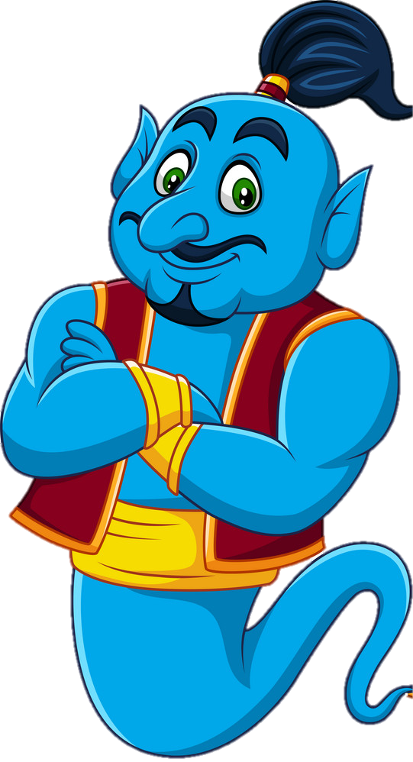

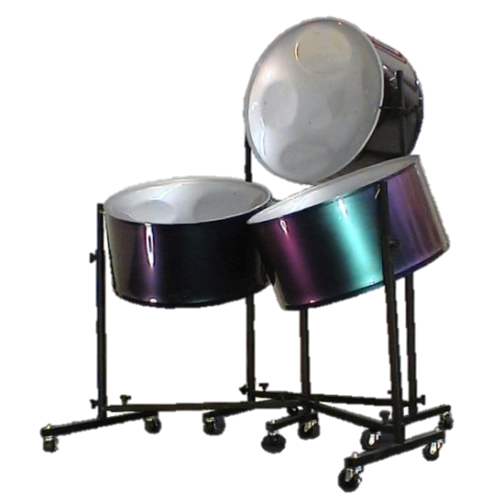

The Right Genie
https://www.youtube.com/watch?v=XUCEHpMNYqE
The Right Genie
I wear curly shoes
and I live in a Lamp,
I say funny things
Like ‘Alikazam!’
I can’t grant your wish,
But I’ll help you succeed,
To do what is right
And get what you need.
The right genie plays by the rules.
The right genie doesn’t lose his cool.
You need hope or good advice?
This genie just
Might change your life.
I’ve got a gold ring
And a carpet that flies,
But other than that
I’m a total surprise.
I won’t do your will,
But I can be of help,
By showing you ways
of helping yourself.
The right genie plays by the rules.
The right genie doesn’t lose his cool.
You need hope or good advice?
This genie just
Might change your Life.
When a situation’s tragic
And you need a little magic
That could make things
Good as new,
Though I’m definitely not a
Second Harry Potter,
I can still turn cloudy skies blue.
The right genie plays by the rules.
The right genie doesn’t lose his cool.
You need hope or good advice?
This genie just
Might change your life.

Slide 9

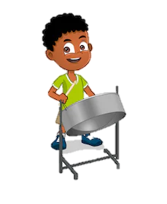
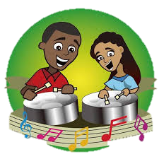
Jammin’ In The Street!
https://www.youtube.com/watch?v=K92RkQ61wtM
Down at the shelter
We’d keep out of trouble:
Making music, making friends.
You turn our shelter
To a heap of rubble.
Makes us angry, makes no sense.
No one stopped to say,
“Hey kids, would it be OK
If we spoilt your hideaway
To make room for a pay-and-
Display?”
So we’re jammin’ in the street,
Gonna tell the town
What’s been goin’ down.
We’re jammin’ in the street,
Wanna tell the major
We ain’t treated fair.
So we’re jammin’ in the street,
Gonna tell the town
What’s been goin’ down.
We’re jammin’ in the street,
Wanna tell the Mayor
We ain’t treated fair.
Jammin’ in the street,
Nothing else to do,
Nowhere else to play,
Might as well stay
And jam all day.
Jammin’, jammin’ (x16)
Jammin’!
Jammin’ in the street,
Nothing else to do,
Nowhere else to play,
Might as well stay
And jam all day.
Come to the Town Hall
Looking for some answers:
Want some reasons,
Want some facts.
Down at the Town Hall
Seems nobody wants us.
There are questions we must ask.
Why did no one say,
“Hey kids, would it be OK
If instead of all those funky tunes
We filled the air with petrol fumes?”

Slide 10


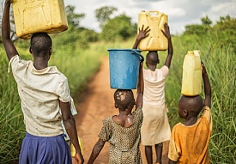
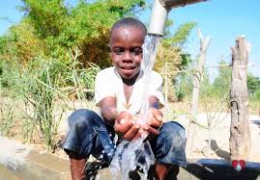
Walking For Water
https://www.youtube.com/watch?v=L-zVPvedCkM
Sister, how you did you spend your day?
What did you learn,
What did you play?’
No time for lessons,
No time for un,
Did a hard day’s work
and it’s not all done.
Walking for water, walking for water,
Walking for water, walking for water,
On the road by sunrise.
Walking for water, walking for water,
Walking for water,
Every day, every day of my life.
Brother, how you did you spend your day?
What did you learn,
What did you play?’
Too weak for lessons,
Too weak for fun,
Sat and prayed for rain,
But it never come.
Waiting for water, waiting for water,
Waiting for water, waiting for water,
Watching all our crops die.
Waiting for water, waiting for water,
Waiting for water,
Every day, every day of my life.
Children, how did you spend your day?
What did you learn,
What did you play?’
The well was opened,
The village sang,
There were tears of joy
As we washed and drank,
As we washed and drank.
Wonderful water, wonderful water,
Wonderful water, wonderful water,
Sparkling in the sunlight.
Wonderful water, wonderful water,
Wonderful water,
Every day, every day of our lives.
Every day, every day of our lives
Every day of our lives (x2)
[Walkin’, walkin’ for water, (x9)
ev’ry day, ev’ry day of our lives. (x2)]

